Slide 1




Coupon Application
Sanam Jena
Shikha Soneji
Anirudh Das
Jonathan Ho
Aniket Chavan

Slide 2


What is a Coupon?
A coupon is a ticket made for people interested in saving money.
These coupons are a kind of discount offer or sale that can be used by the customers while purchasing a product or service.
Promotional codes, voucher codes, etc. are various forms of coupon styles that offer financial discount or rebates on purchases.

Slide 3
User Story

Slide 4
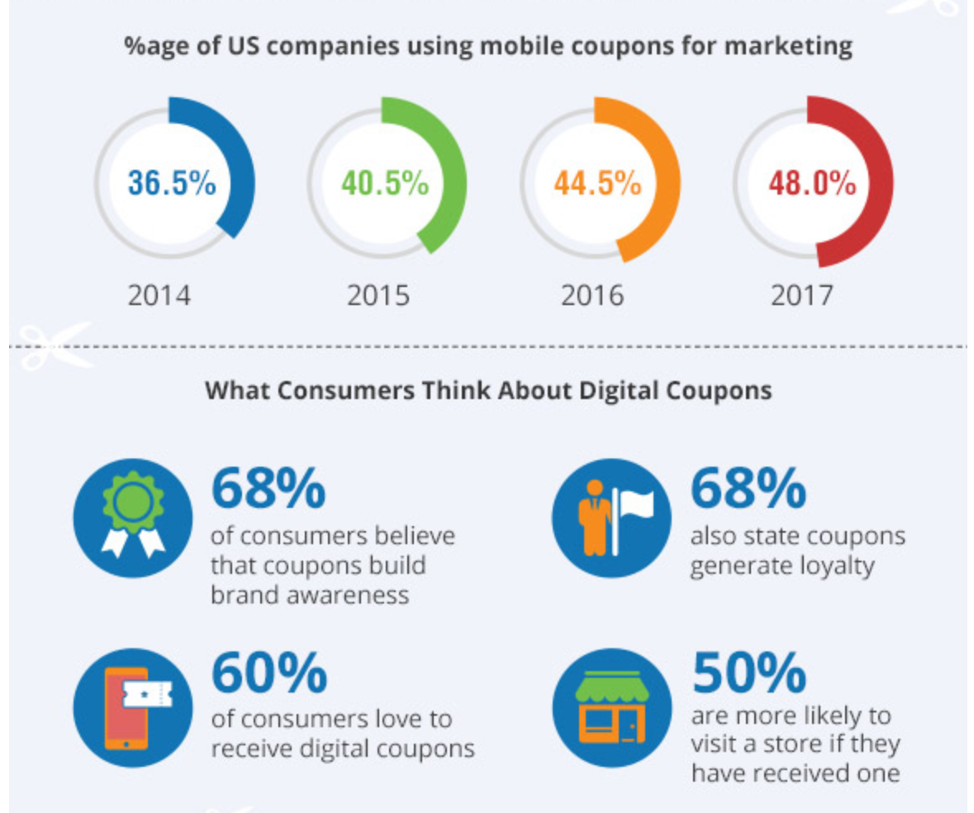
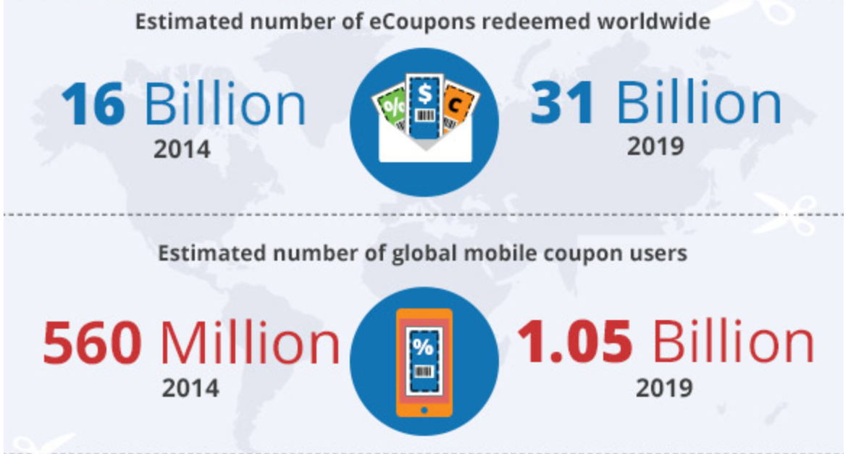
Coupon Statistics
Source: https://www.invespcro.com/blog/digital-coupon-marketing/

Slide 5
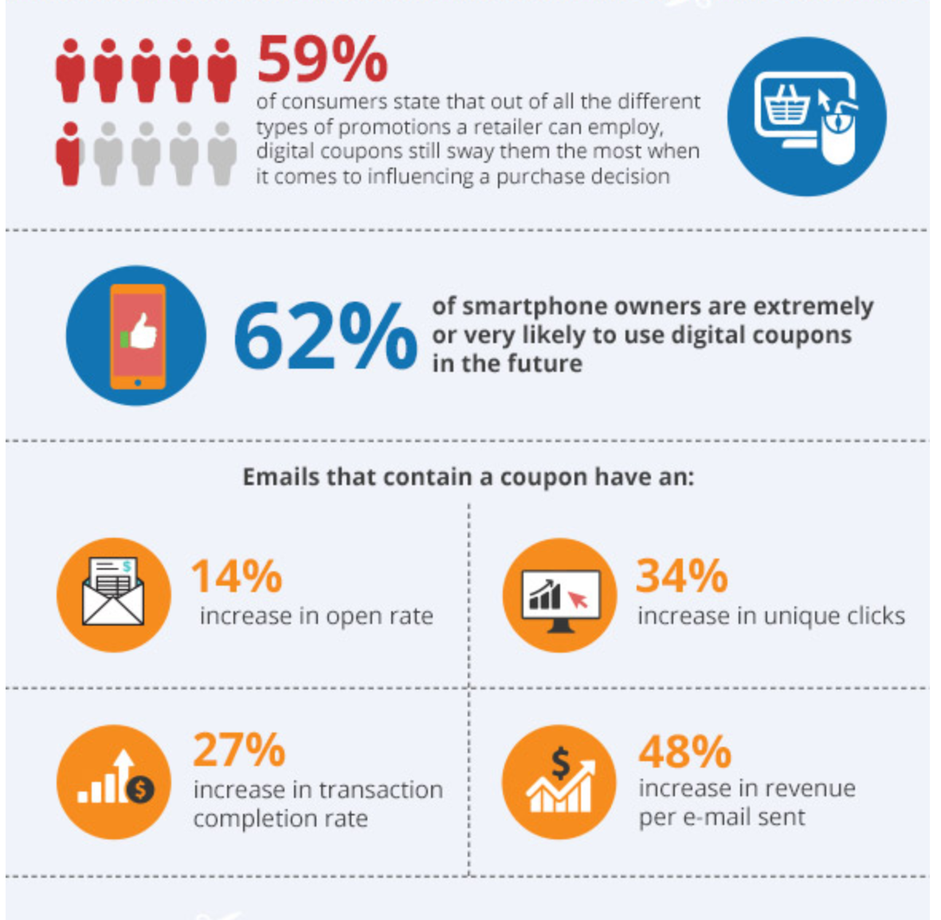
Source: https://www.invespcro.com/blog/digital-coupon-marketing/

Slide 6
Problem Statement
Audience
To develop an application, where users can collect discount coupons from and use them on partner websites to get the same product at discounted prices
All online buyers looking to save money

Slide 7


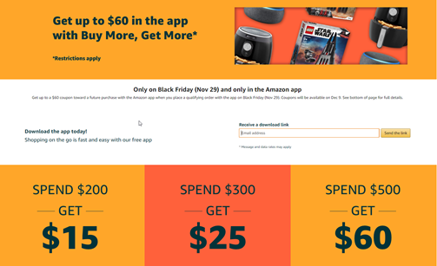
Core Features
MAIN PAGE
Users Search for the product to get coupons
Displaying the trending / most used coupons on the Main Page.
VIEW COUPONS
Users get to view all the coupons from the partner websites who are offering those discounts.

Slide 8
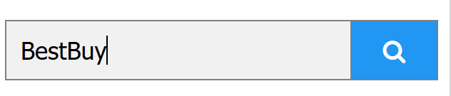
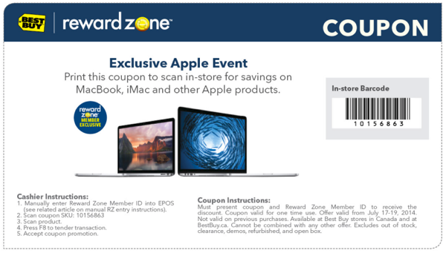
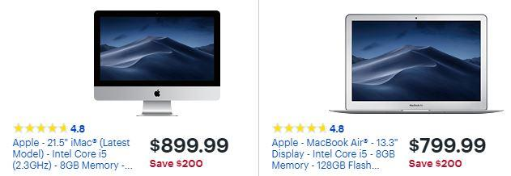
1
2
Apply
3

Slide 9


Core Features
Creating Upvote / Downvote buttons.
Creating threads for comments.
Calculating and displaying success rates of the coupons as reported by the users.
Moderation of Coupons.

Slide 10

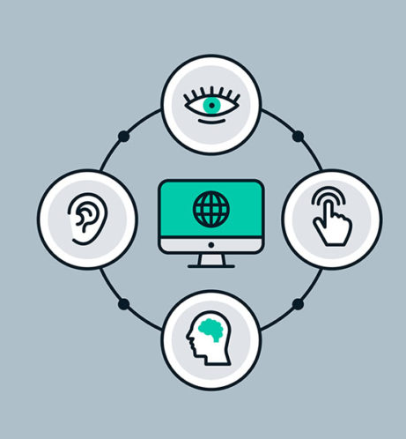
Additional Features
Additional Features
Social Media Sharing
Web Accessibility

Slide 11
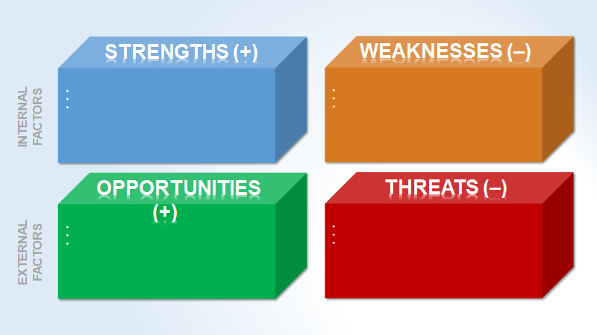
Great Savings
Authenticated Coupons
Good Collection of Coupons
No Automatic Application of Coupon
Automation of Coupons
Integrating the web service as a plugin
Competitor
Direct Purchase / Store Purchase

Slide 12
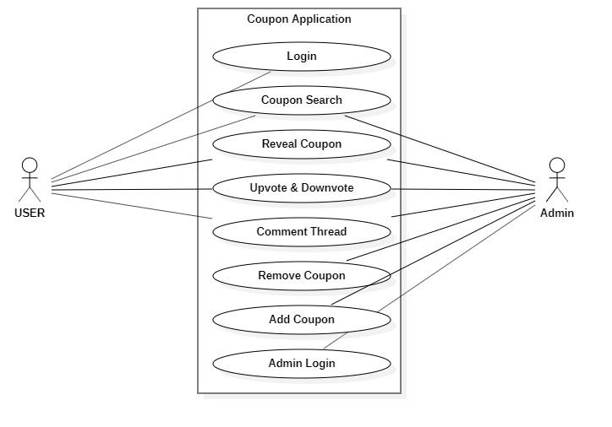
USE CASE DIAGRAM

Slide 13
Roles
Sanam Jena Anirudh Das
Backend Development Routing
Shikha Soneji
Frontend and UI
Jonathan Ho Aniket Chavan
Testing and QA Backend and Logic

Slide 14


